Slide 1
Hello from NYC usually that’s a good thing…..

Slide 3
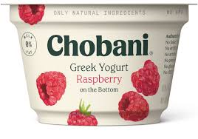
3 Emerging Clusters in Creativity – there is need for care
Functional relevance and re-assurance
Situational Context Led
Genuine higher order ownership
This is what we do
This is what were doing now
This is what we’ve always done

Slide 4
3 Scary Media Issues
Eyes not hearts
An even stranger summer (than usual)
Frequency Time-bomb
Time
Now
Lets pretend Q4

Slide 5
Partnership – where are you, where are your clients ?
SELLING LISTENING
SURVIVAL CREATIVITY
CLARITY ACTION
MARKETING SALES (and Finance )

Slide 6
Q&A Feel free to open one of these, Business is tough + You’re at home

